Slide 1
Machine Learning - Introduction
Model and Prediction

Slide 2
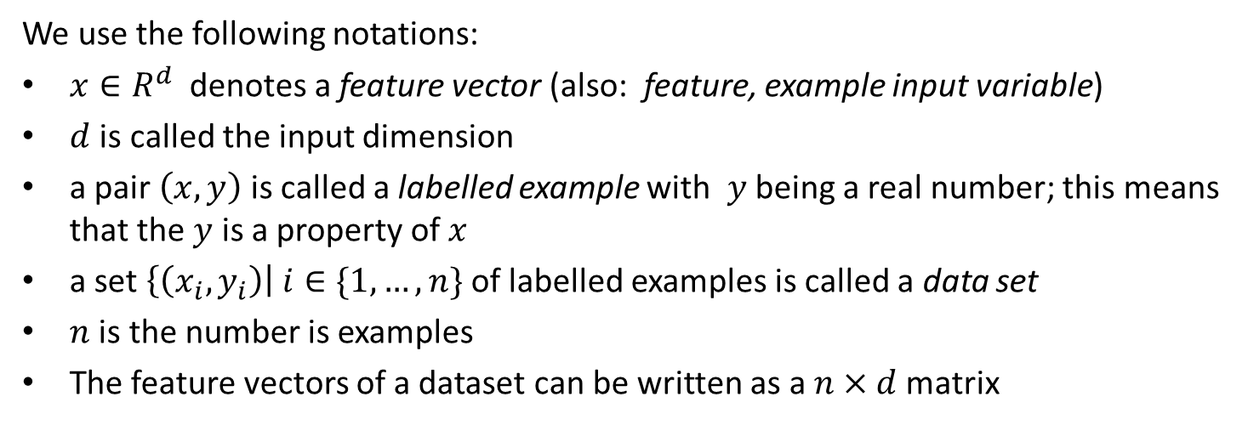
To remember
We use the following notations:
$x∈R^{d}$denotes a feature vector (also: feature, example input variable)
$d$ is called the input dimension
a pair $\left(x,y\right)$ is called a labelled example with $y$ being a real number; this means that the $y$ is a property of $x$
a set $\left\{\left(x_{i}, y_{i}\right)\right| i∈\{1,…,n\}$ of labelled examples is called a data set
$n$ is the number is examples
The feature vectors of a dataset can be written as a $n×d$ matrix

Slide 3
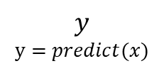

We see a Neural Network as a Black Box transforming feature vectors into labels.
We call a Neural Network with a given set of values for weights and biases a Model.
Neural
Network
(„predict“)
$$x$$
$$y$$
$$y=predict(x)$$

Slide 4
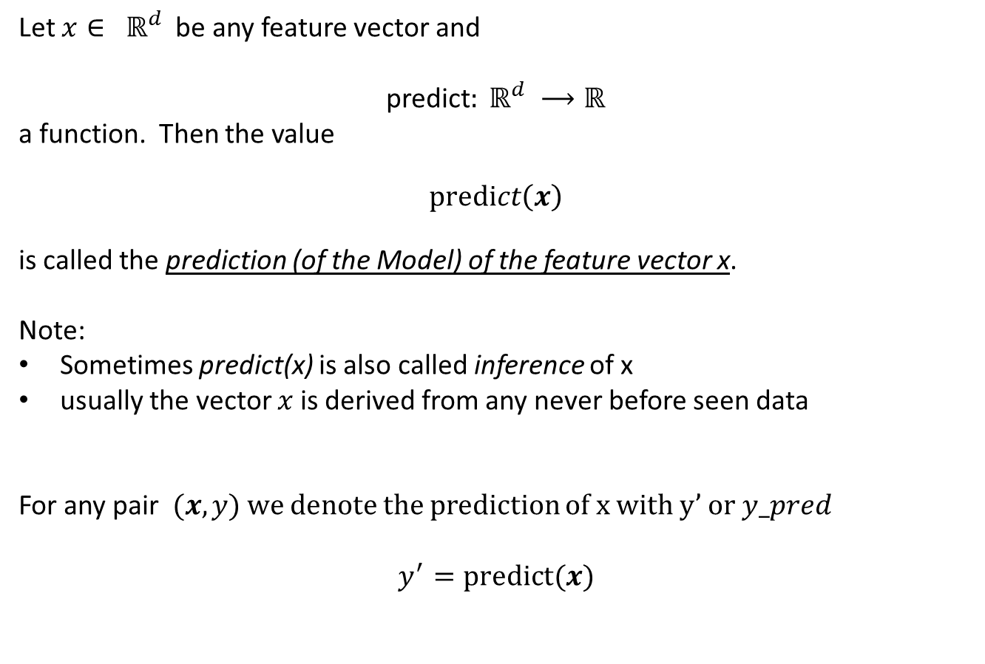
Prediction for a Model
Let $x∈ ℝ^{d}$ be any feature vector and
predict$: ℝ^{d} ⟶ℝ$
a function. Then the value
$predict\left(x\right)$
is called the prediction (of the Model) of the feature vector x.
Note:
Sometimes predict(x) is also called inference of x
usually the vector $x$ is derived from any never before seen data
For any pair $(x,y)$ we denote the prediction of x with y’ or $y_pred$
$$y^{′}=\text{predict}(x)$$

